Slide 1
Note to Oracle Sales Teams
The following Sales Win slides document why our customers purchased Oracle Converged Infrastructure hardware products
The slides are created after the deal closes with data from sales teams who have been interviewed
These slides can be used with customers
Do not provide a soft copy of these slides to customers with speaker notes intact
There are customer specific details in the speaker notes to provide more context that should never be provided to customers. These notes are HIGHLY CONFIDENTIAL
Other interesting sales wins can be found in the Wins2References tool
Note: These stories cannot be shared externally

Slide 2
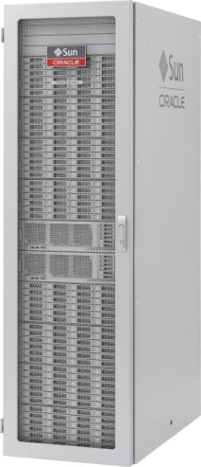
Virtual Storage Manager
February, 2018

Slide 3
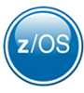
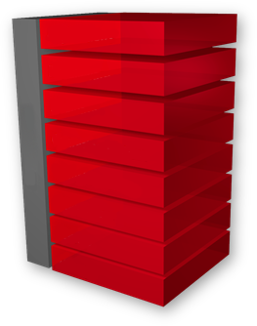
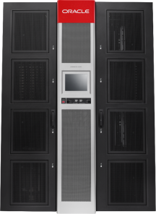
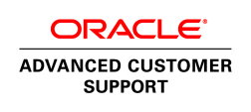
Large Insurance Company
Takeout
Mainframe Data Protection Modernization
Massive improvements in scalability, reduced operating expenses
Scale for Business Growth
Reduced Complexity
Faster, Lower Priced Solution
Massive performance and scalability improvement
Migrated data from old to new systems with no impact on production jobs
Lowered acquisition and operational costs vs IBM
Production Site
DR Site
Data protection jobs got faster response with minimal operational changes for the staff
Increased disk scalability 80X in a single frame, 21,000X for the overall system
Replace IBM with Oracle StorageTek Virtual Storage Manager
Applications
Replicate
Middleware
Database
Management
OS
Migrate
StorageTek T10000
Drives
VM
Networking
VSM
StorageTek Virtual Storage Manager Version 6
SL8500, T10KD
StorageTek SL8500 Modular Library System
Updated 22 July 2016
Notes:
Customer Background
The customer is one of the largest insurance companies in Latin America.
Oracle Products
StorageTek VSM6
StorageTek SL8500
StorageTek T10000D Enterprise Drive
ACS Services
The Opportunity
Update 20 IBM Virtual Tape Libraries and TS3500 tape libraries
Why Oracle?
Able to migrate the data from old to new systems in the background with no impact on production jobs.
The jobs got faster response, with minimal operational changes for the staff.
Lower price, higher performance.

Slide 4
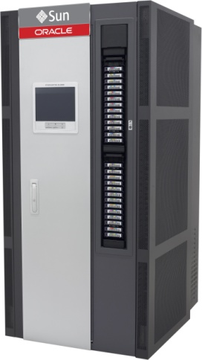
Major Telecommunications Company
Takeout
Mainframe Data Protection Modernization
Significant data protection performance improvements and reduced OPEX
Capacity for Business Growth
Enhanced Data Protection
Lowest Total Cost of Ownership
Increased scalability by 35X and potential performance by 50X
Cross-replication improved availability at production and DR sites
Displace aging IBM infrastructure with latest storage technologies
Production Site
DR Site
Legacy IBM mainframe backup solutions was outdated and support was getting very expensive
Expect to leverage this SL3000 for new, additional archive projects
Applications
Replicate
Middleware
Database
Management
OS
Migrate
StorageTek T10000
Drives
VM
StorageTek Virtual Storage Manager
Networking
VSM
SL8500, T10KD
StorageTek SL3000 Modular Library System
Updated 3 May 2016
Notes:
Customer Background
· A major Latin American telecommunications company
Business Challenges
· Upgrade their mainframe backup environment to improve performance while reducing their operating expenses.
Oracle Products
· Oracle StorageTek Virtual Storage Manager, Version 6
· StorageTek SL3000 Modular Library System
· StorageTek T10000D Tape Drives
· Oracle Advanced Consulting Services
The Opportunity
· Replace IBM solution with new Oracle StorageTek Mainframe backup solution
· Consolidate additional workloads on the SL3000
Why Oracle?
· Lowest TCO
· Fastest Performance
· Flexibility and Scalability to expand in the future

Slide 5
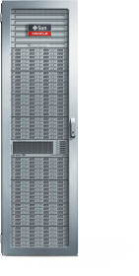
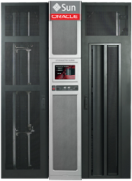
Nedbank Group
Beat
Banking Data Protection Modernization
Increased storage density more than 112x, with zero downtime during implementation
Significantly Increased Density
Enhanced Data Protection
Zero-downtime Migration
Increased potential tape capacity by 112x and disk by 10x with no increase in footprint
Cross-replication improved availability at production and DR sites
Zero downtime during implementation
Production Site
DR Site
Increased disk storage throughput by 5x, and increased potential capacity by 10x
Increased storage density 112x by consolidating T9840D to T10000D tape drives
Zero downtime at production and disaster recovery sites during the implementation, cutover, and migration
Applications
Replicate
Middleware
Database
Migrate
Replicate
Management
OS
StorageTek Virtual Library Extension
StorageTek Virtual Storage Manager
VM
Networking
StorageTek SL8500 Modular Library System with StorageTek T10000D Tape Drives
VSM, VLE
SL8500, T10K
Updated 3 May 2016
Notes:
Customer Background
One of South Africa's largest banking groups with a wide range of wholesale and retail banking services.
Business Challenges
Steady increase in demand for backup processing due to the rapid growth of data as well as increased awareness of the need for data protection.
"These demands, combined with diminishing backup and batch windows, put huge strain on the existing mainframe backup solution"
Oracle Products
StorageTek Virtual Storage Manager version 6 (VSM6)
StorageTek Virtual Library Extension
StorageTek SL8500 modular library system
StorageTek T10000D tape drives
The Opportunity
Upgrade their existing StorageTek tape environment which consisted of StorageTek VSM5 systems, SL8500 tape libraries and T9840D tape drives.

Slide 6
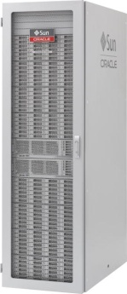
Large French Bank
Beat
Data Protection Modernization
Improved overall data availability and lowered costs while increasing growth capacity
Enhanced Data Protection
Lowered Total Cost of Ownership
Capacity for Business Growth
Cross-replication improved availability at production and DR sites
Reduced costs by 50% through upgrading to latest VSM6
Increased performance by 3X and capacity by 17X for future growth
Site 1
DR Site
Site 2
Upgraded to latest Virtual Storage Manager, version 6 to significantly reduce costs while improving availability
Cross-replication used between 3 different VSM locations to dramatically improve availability
Increased capacity to eliminate need for future disruptions for disk upgrades
Applications
Replication
Middleware
Replication
Database
Management
OS
VM
Networking
Server
VSM
StorageTek Virtual Storage Manager, Version 6
Updated 10 Dec 2015
Notes:
Customer Background
A major French bank.
Business Challenges
Implement a solution that would support two production sites in a single campus, plus a long distance DR site that was 300KM away.
Oracle Products
StorageTek Virtual Storage Manager version 6 (VSM6)

Slide 7
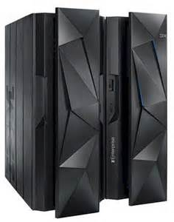
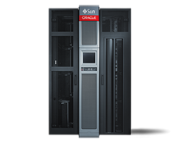
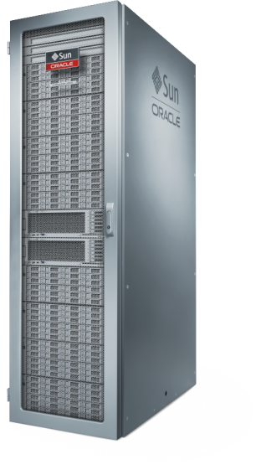
Multinational Bank and Financial Services Company
Beat
High Available Backup, Archive, Disaster Recovery for Mainframe Data Center
Highly available, scalable data protection for new mobile computing and business applications on mainframe
Reduce Risk
High Availability Backup and DR
Better TCO
Reduced risk and improved operation efficiency with virtual tape drive
Full fault tolerant data protection architecture
Compatibility with earlier generation systems
Fully automated tiered storage solution for the mainframe
>2X Performance Improvement with VSM 6
17X higher capacity with VSM 6
Dual Processing nodes within appliance allows for high availability
Non Disruptive Code Loads to simplify software updates
PeopleSoft, Siebel
Middleware
StorageTek SL8500 Tape Libraries
Database
IBM Mainframe
Management
Solaris, OL
LDoms
StorageTek VSM6s
Networking
SPARC, x86
VSM 6
StorageTek VSM6 System, StorageTek SL8500 and T10000B Tape Drives
Updated 23 Jul 2014
Notes:
Customer Win: Major UK Bank
The Deal
Upgrade and consolidate over 15 Oracle StorageTek VSM 5 systems to VSM6 and modernize drive technology in existing StorageTek SL8500s. Eliminated upstart IBM installation due to it’s high complexity and lack of resilience.

Slide 8
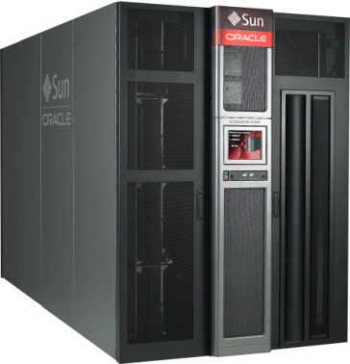
Recovery Point
Beat
Disaster Recovery Cloud Solution
New business opportunities with government customers for Disaster Recovery Services
Faster Performance
TCO Savings
Improved MTTR
2x faster system performance
Saved 50% by upgrading to VSM6
3X less downtime and full system redundancy
Higher Security with T10000DC encryption managed by Oracle Key Manager
Consolidated library slots and drives by upgrading from obsoloil tape technologies to the StorageTek T10000D
Applications
Middleware
Database
Oracle Key Manager
Management
OS
Virtual Machine
StorageTek T10000D
StorageTek VSM6
StorageTek SL8500
Networking
Servers
Storage
Updated 12 Jun 2014
Notes:
Recovery Point is a leading national provider of integrated Business Continuity and Disaster Recovery Solutions. They serve a diverse client base of Federal, state and local government agencies, as well as commercial organizations ranging from the Fortune 500 to small businesses. Their facilities and recovery centers are located in Maryland, Wisconsin, Pennsylvania and Illinois. From the mainframe to the desktop, we offer the complete range of resources required for the client's organization to survive a catastrophic event and keep their applications and business processes running. This is a Net New and very strategic win for OD. What was sold:
SL8500 with 5000 slots - full redundancy - T10000D drives with Encryption
VSM6 with 10Tb capacity to emulate VTDs to RTDs for the MainFrame environment
OKM 3.0 Fully Redundant to manage Encryption keys for all drives
Enterprise Library Software
This is a “Net New” customer to Oracle. They had, for years, not been able to bid on any government projects that required Oracle products and this project allowed them to purchase products that will now enable them to bid on RFPs that include our products.

